Slide 1
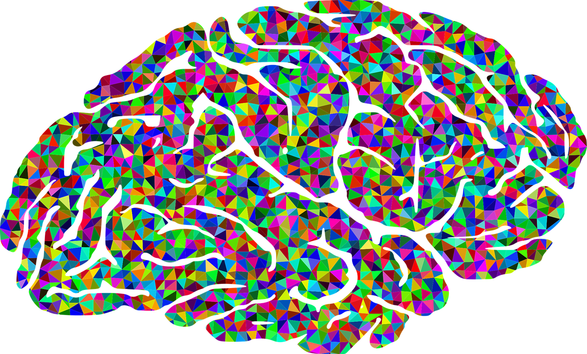


The Brain and Epilepsy

Slide 2

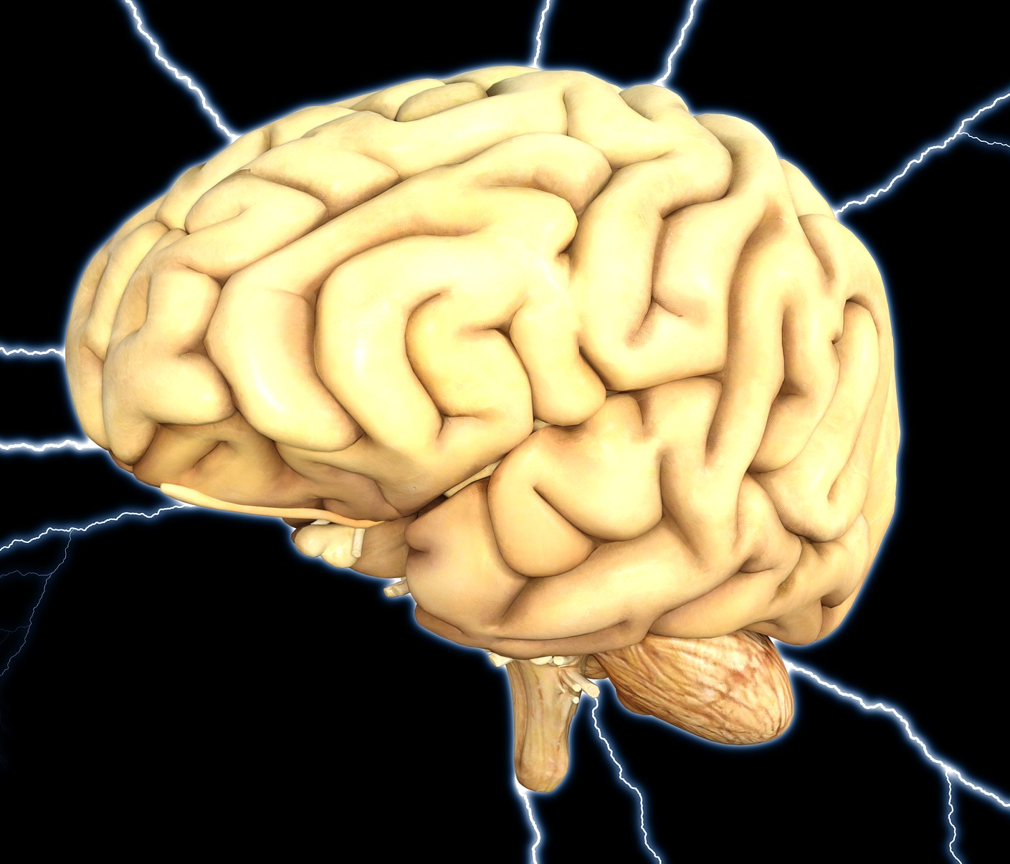

The Human Brain
The human brain weighs about 3 pounds
Your brain has about 100 BILLION brain cells called neurons
Your brain is made up of about 75% water
Your brain produces enough electricity to power a lightbulb!
There are TRILLIONS of brain cell connections in your brain
Notes:
Read brain facts from slide.

Slide 3
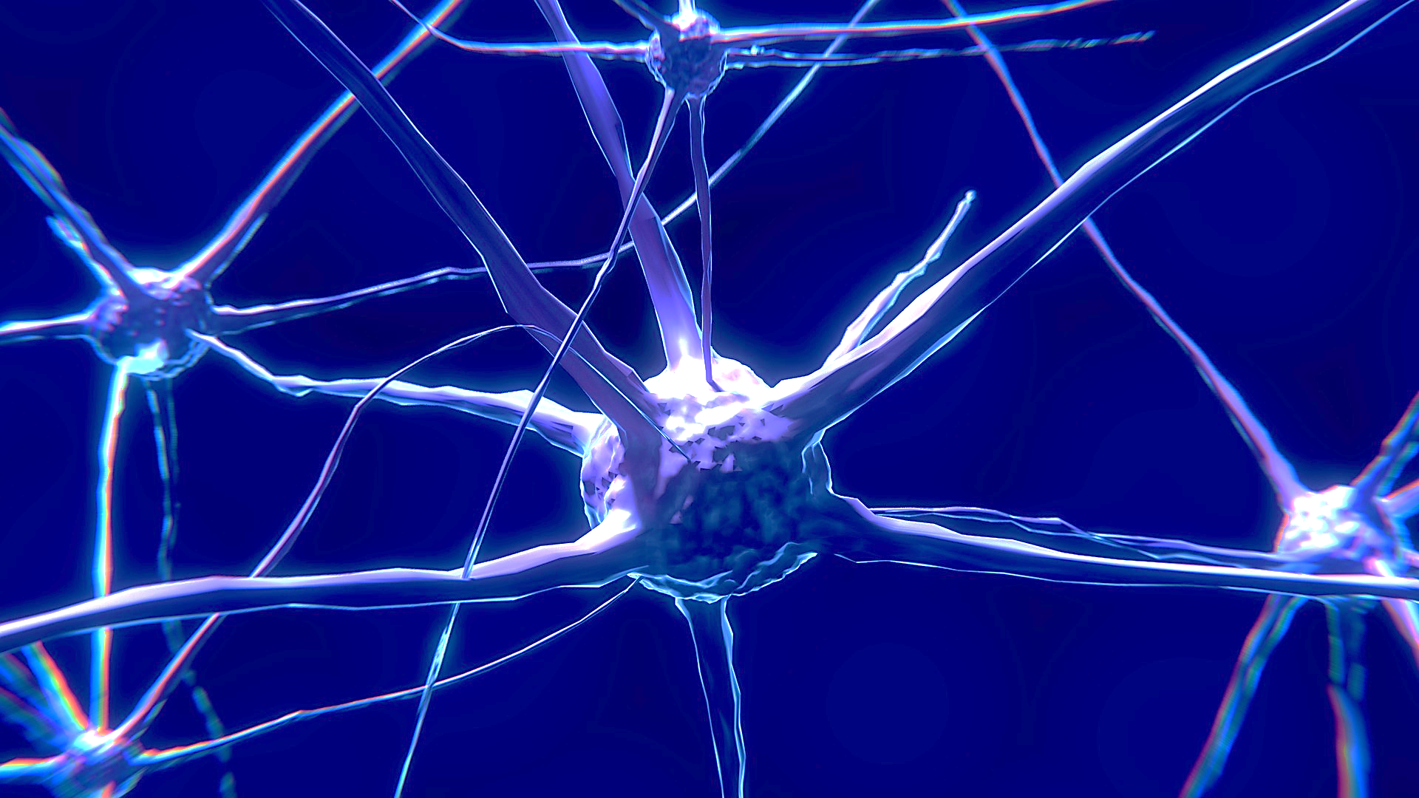
How do brain cells communicate?
Neurons are cells in the brain that tell your body what to do
Neurons send electrical signals to “talk” to each other
Neurons’ electrical signals travel super fast – some over 200 miles an hour!
Neurons send signals all the time – even when you are asleep!
neuron
Notes:
The human body is made up of different kinds of cells. The cells in the brain are called neurons, and you can see a picture of a neuron here on this slide.
Just like you communicate with your friends and your family by talking, the cells in your brain, called neurons, communicate with one another.
They “talk” to one another by sending and receiving electric signals.
These signals travel super fast .
This brain cell “talking” never stops, it is happening all the time, even when you sleep!

Slide 4

Brain Body Connection
Electrical brain signals help us to :
think, read, do math, write, draw, paint, build
speak, listen, understand, learn new things
stand, sit, walk, run, jump, dance, kick a ball, smile
see light, darkness and all the world around us
hear sounds, sing, play the drums, play video games
sense hot or cold, smooth or prickly, salty or sweet
feel happy, sad, afraid, brave, excited, nervous
control breathing, heart rate, digestion, body temperature, sleep
(just to name a few…..)
Notes:
The electric signals that the brain cells send help us to control many different things.
Electric brain signals help us to think, read, speak, listen, walk, dance, see, hear, feel hot and cold, taste salty or sweet, feel happy or sad.
Our brain signals also help to control important body functions like our breathing, our heart rate, our digestion, body temperature and our sleep!

Slide 5
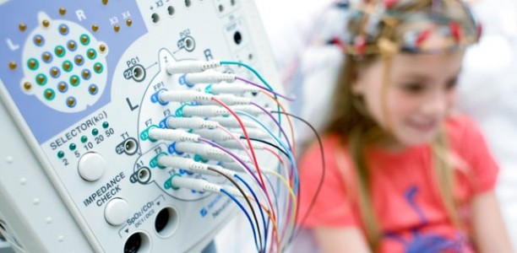
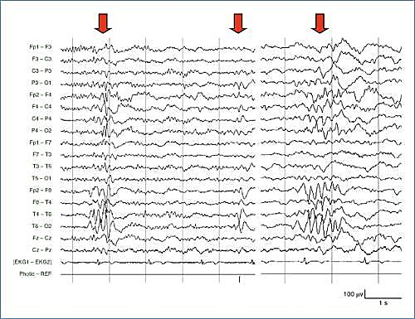
Can you see brain signals?
Brain signals can be recorded with an EEG test
Electro-Encephalo-Gram
electric
brain
recording
This Photo by Unknown Author is licensed under CC BY-SA
Notes:
There are different ways to see what the brain looks like and how it is working.
One way to see brain signals is with a test called an EEG – this test measures electric brain signals and records them.
When a person has an EEG a special health care worker will place little sticky recording pads on a person’s head; these recording pads help to measure the electric signals that are being sent in the brain. When the test is done, all the sticky pads are removed and the recording is sent to a doctor who will look at the recording of electric brain signals. This test helps the doctor to know how to best help a person.

Slide 6
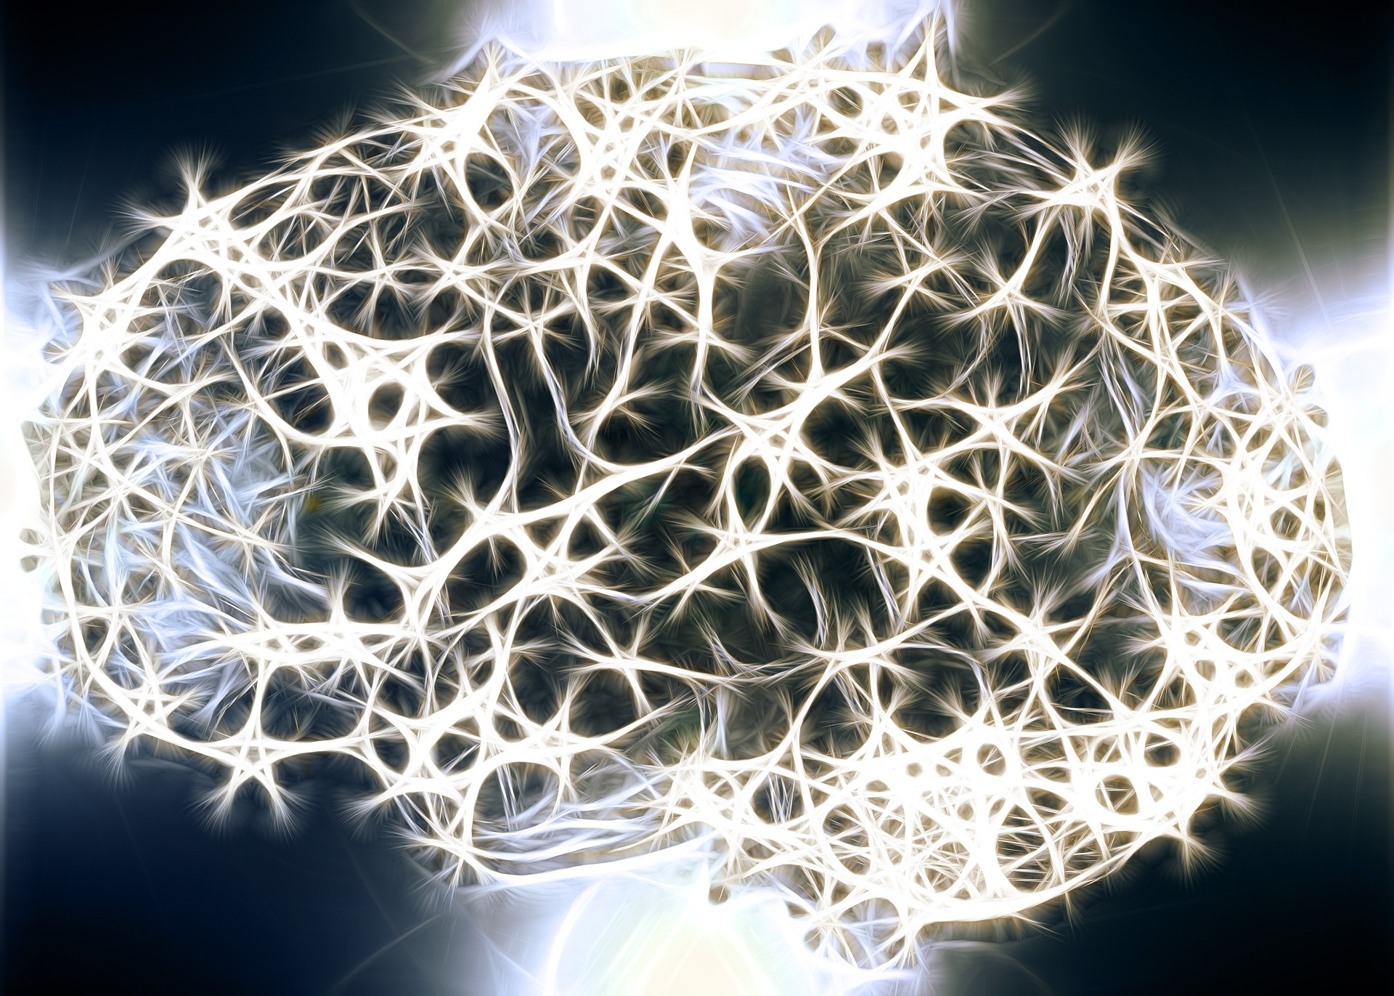
What is a seizure?
A seizure is a symptom of epilepsy.
Someone having a seizure might
have a change in:
the way their body moves
the sensations that they feel
how they speak or act
how they respond to you
how awake they are
Notes:
A seizure is a symptom of a brain disorder called epilepsy. There are many kinds of medical disorders that involve the brain. Epilepsy is just one of them.
You might have friends with other medical problems like diabetes or asthma that sometimes have symptoms. For example, a person with asthma might have trouble breathing sometimes. Seizures are a symptom of epilepsy.
Someone having a seizure might have a change in the way they move, feel, speak or act. Seizures can sometimes make it hard for a friend to respond to you and sometimes seizures can affect how awake a person is.

Slide 7






Why does a seizure happen?
A seizure happens when neurons send too many electric signals at one time.
This is like an electrical “storm” that happens in the brain.
Who can have a seizure?
Anyone can have a seizure.
1 out of 10 people will have a seizure during their lifetime.
Notes:
Remember when we talked about how brain cells talk by sending electric signals. Well a seizure can happen when there are too many electric signals at the same time and get mixed up. This is like an electrical “storm” that takes place for a short time in the brain.
You might be wondering who can have a seizure? Anyone can have a seizure. One in 10 people will have a seizure during their lifetime.

Slide 8


What else should I know about seizures?
Seizures are hard to predict.
Most seizures last a few seconds to a few minutes and then stop.
A person having a seizure cannot control what is happening.
If you think someone is having a seizure, let a grown up know.
A person might feel sleepy after a seizure and need to rest.
Seizures and epilepsy are not contagious.
Notes:
What else should everyone know about seizures?
Seizures are hard to predict.
Most seizures are short, they last from a few seconds to a few minutes and then stop.
The person having the seizure cannot control what is happening
If you think someone is having a seizure it is VERY important that you let a grown up know right away
After a seizure, a person might feel sleepy and need some time to rest. Know that your friend will be okay and that they will really appreciate your being kind and a good friend to them when they come back to the classroom.
Seizures and epilepsy are not contagious.

Slide 9
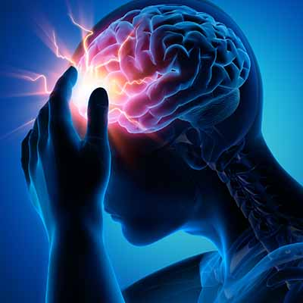
What is epilepsy?
Epilepsy is a medical condition that causes someone to have seizures.
Who has epilepsy?
ANYONE can have epilepsy.
65 million people around the world have epilepsy.
Almost half a million kids in the United States have epilepsy.
1 in 26 people will have epilepsy during their lifetime.
Notes:
Read from slide.

Slide 10
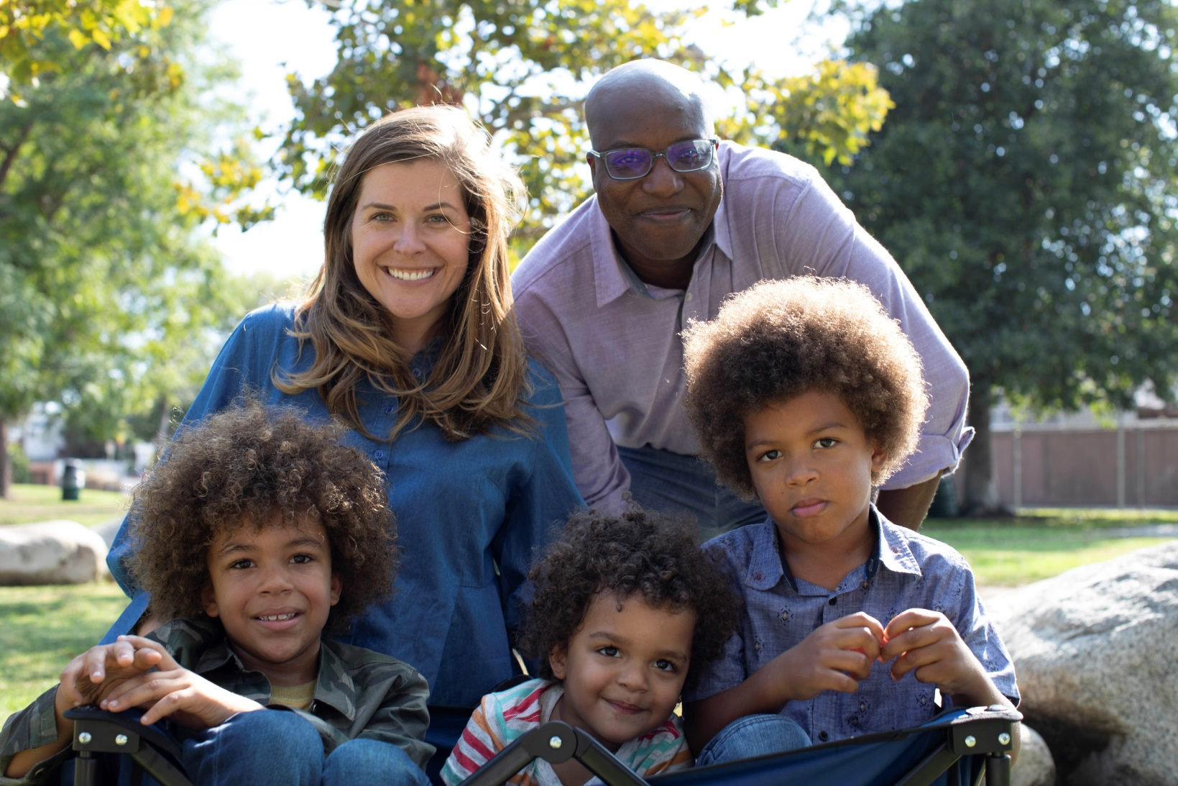

Can I tell if someone has epilepsy?
People with epilepsy:
Go to school and camp
Play sports
Hang out with friends
Go to college
Work
Travel
People with epilepsy like to laugh, have fun, learn new things, have hopes and dreams just like you!
There is no way to know by looking at someone if they have epilepsy.
Notes:
People who have epilepsy are just like everyone else, but sometimes they might have a seizure. You can’t tell from the outside if someone has epilepsy. Many people have epilepsy. It is a very common medical disorder.
Read text from slide

Slide 11


Who helps people with epilepsy?
Doctors and nurses help people with epilepsy. They treat them with:
      Medicines that stop seizures
      Special diets that help to stop seizures
      Some people have surgery to stop seizures
Notes:
Just like with other medical problems, there are health care teams who help people with epilepsy. Doctors and nurses help people with epilepsy.
They can treat people with medicines that stop seizures. Some people will also have a special medical diet to follow that helps to stop seizures.
Sometimes, a person might have surgery to stop seizures.
There are many different kinds of treatments for epilepsy.

Slide 12

How can I help if
a friend has a seizure?
STAY with your friend.
Send someone near you to tell a grown up your friend is having a seizure.
Keep your friend SAFE. Move away sharp or hard objects they could get hurt on. Put something soft under their head, like a sweatshirt or a jacket.
Gently turn your friend on their SIDE
NEVER hold them down or put anything in their mouth.
When the seizure is over be a good friend. Be kind.
Notes:
Everyone can help if a friend has a seizure. Don’t worry, you won’t get hurt helping someone with a seizure.
Read from slide
It can feel uncomfortable to see your friend have a seizure, but try not to worry, stay with your friend, make sure an adult is called for help, and your friend will be okay. Sometimes a person feels tired after a seizure, or a bit confused, but after a bit of time, they are back to their usual self.

Slide 13
People with epilepsy are…
Add your picture or a picture of your loved one here if you would like to
Authors
Athletes
Artists
Actors
Musicians
Teachers
World leaders
Anyone can have epilepsy!
Notes:
Anyone can have epilepsy, even important people and famous people can have epilepsy. People with all kinds of different jobs can have epilepsy. Authors, professional athletes, artists, actors, musicians, teachers, world leaders. Remember, anyone can have epilepsy.

Slide 14
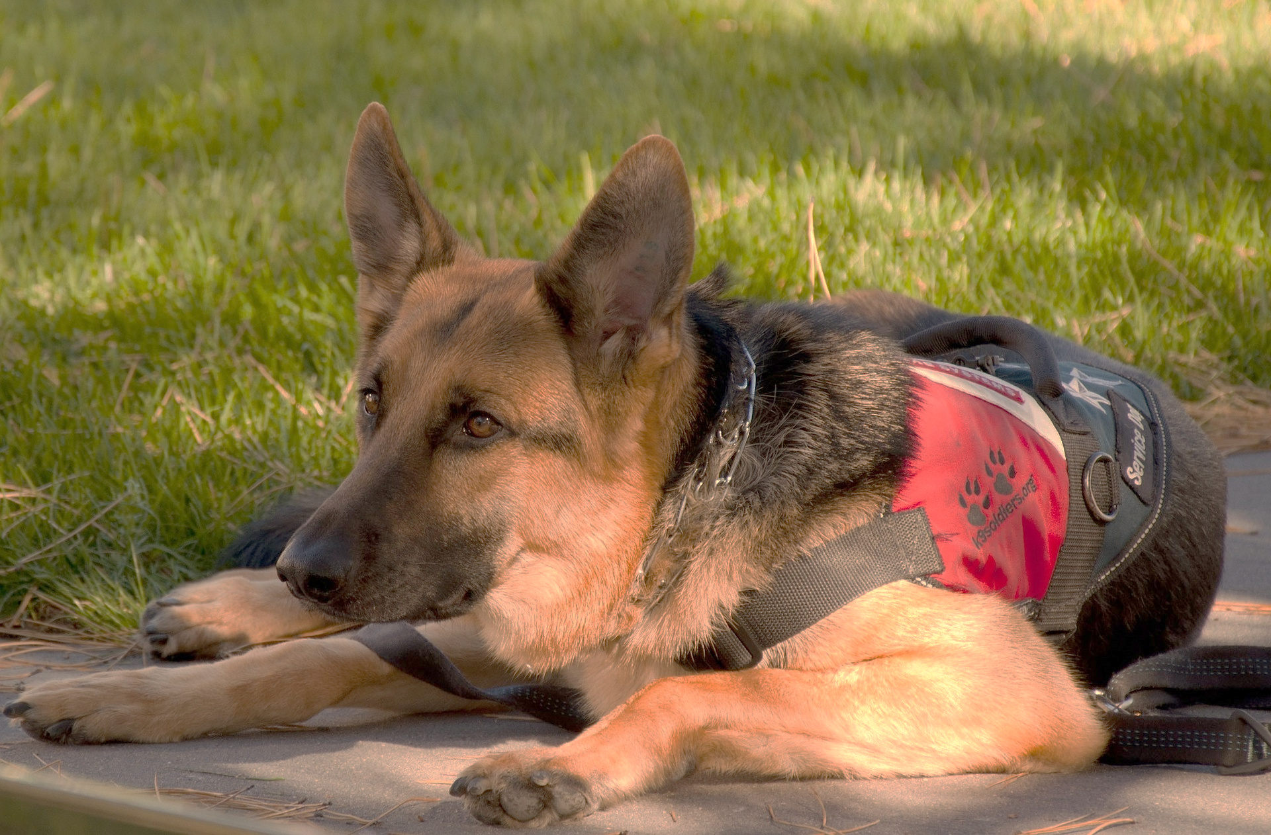
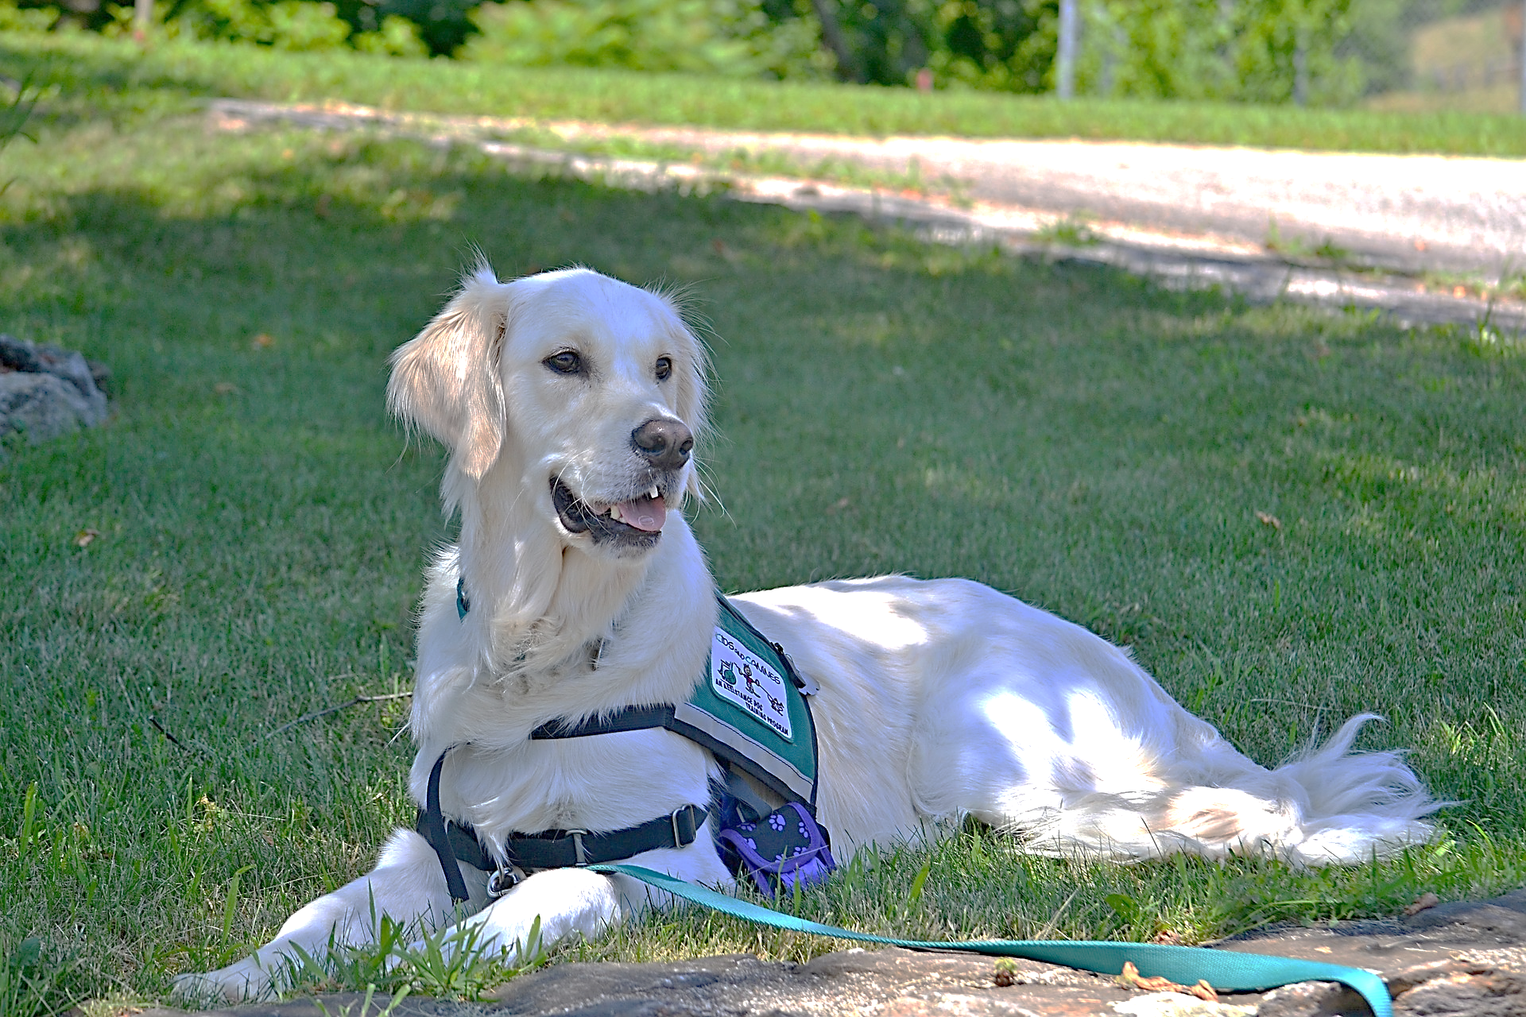
Did you know …
Some people have seizure dogs that help them if they have a seizure
They can help by,
  Barking to let others know a seizure has happened
  Learning to press an alarm button if a seizure happens
  Staying with a person after a seizure happens until help arrives
  Being a good companion
Dogs can also have seizures!
Notes:
You might not know, but some people have seizure dogs that can help them if they have a seizure.
These dogs have special training to help a person who has epilepsy.
They can help by barking to let others know a seizure has happened or learning to press an alarm button.
These dogs know to stay with a person until help arrives and to be a good companion.
Dogs can sometimes have seizures too, and a veterinarian can help to treat their seizures.

Slide 15

Important things to remember:
ANYONE can have a seizure, and ANYONE can have epilepsy.
If you think someone is having a seizure, let a grown up know.
Be a good friend! Always be kind and considerate.
If you have epilepsy don’t be afraid to share your story.
Notes:
Thank you for paying attention today and learning about seizures and epilepsy. There are a few important things we want you to remember,
Anyone can have a seizure, and anyone can have epilepsy.
If you think someone is having a seizure, always let a grown up know.
Remember to be a good friend, that means being kind and considerate.
Epilepsy is very common, if you have epilepsy don’t be afraid to share your story.

Slide 16
Thank You!
Notes:
Thank you for listening to my presentation.
Are there any questions I can answer?

